Slide 1
Print instructions
Open in pdf editor, print poster size.
You will have to trim and tape the pages together
Laminate pages together to use over and over

Slide 2
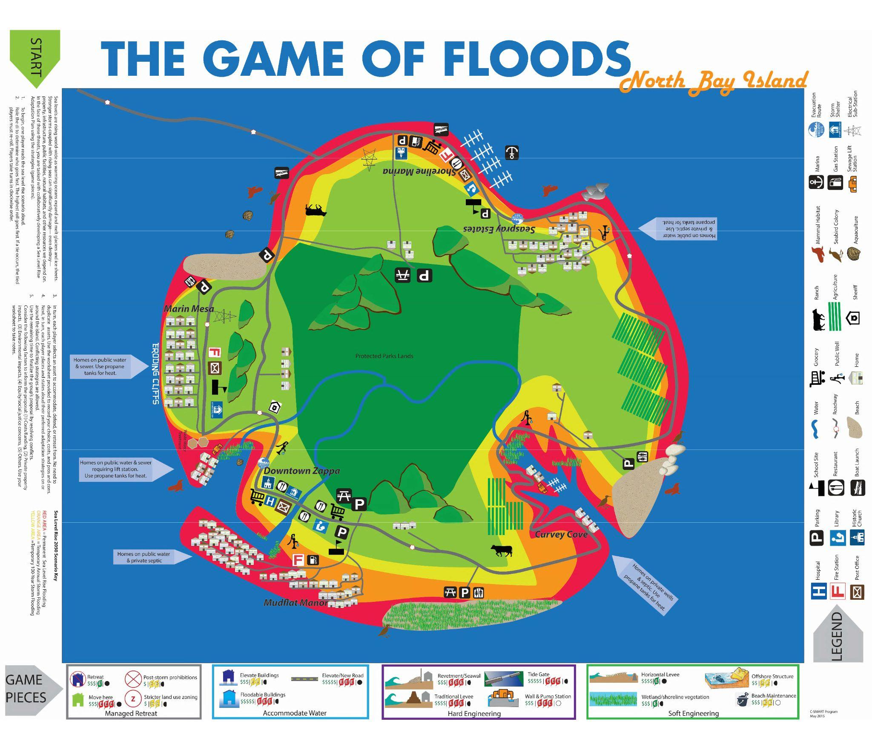


Power Plant
Wastewater Treatment Plant
The person to go first is the player to the left of the Mayor
Choose an asset to adapt or a general adaptation strategy
Example: We need to move the hospital OR We need to install levees along the beach
3. Propose that asset to the group. The group can argue for or against with their roles, budget and scenario in mind.
4. The person who’s turn it is gets the final say on what adaptation to use and what asset to save.
5. Mark on the Map or add a play tile for what you have decided to do. Reference the Map Markers on the game board
6. Add the final decision to the worksheet on page 4
Example: The player in charge of transportation wants to elevate roads in the flood zone. The group discusses whether that is how they want to spend their budget or not. Maybe the Transportation player can make adjustments to some roads but not all. The Transportation player listens and then makes the final decision. Once the decision is final, the player will mark the map with the actions they decided. So the player might mark out old roads and draw in new roads with the marker.
Freshwater Well
Mark out a building to show retreat
Mark out a whole area for no future building
River
Place a new play tile where you want the new building
Stricter Zoning means that some things with low sensitivity can be built here. I.e. parks and beaches but not houses
Draw “feet” under buildings and roads that will be elevated
To pump flood water back into the sea

