Slide 1
Aspects of Climate
Ocean

Slide 2

Benefits of the Ocean
Why is the ocean important for habitability?
Make a list of all the environmental services humans get from the ocean
Regulates temperature
Food
Rain water is evaporated from here
Hold CO₂ so the air isn’t so warm
Phytoplankton produce O₂ for the atmosphere

Slide 3
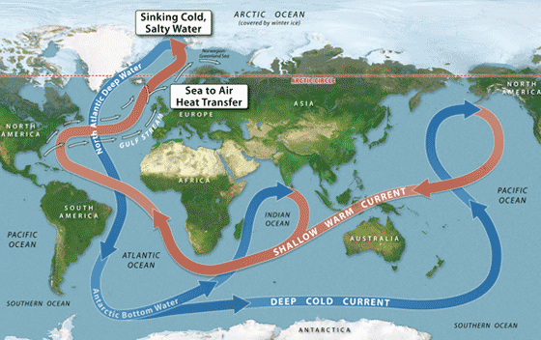
Oceans move heat
Air temperature affects the ocean
Ocean affects the air temperature.
Heat moves from the equator toward the poles (surface)
Cold water moves from the poles to the equator (deep)
Water holds heat and regulates the temperature of coastal cities

Slide 4
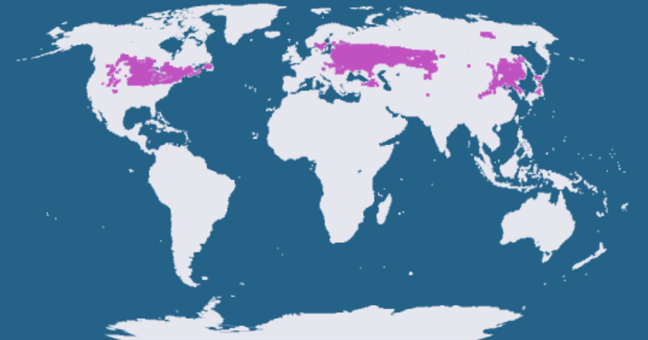
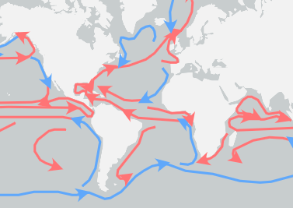
How do ocean currents impact climate zones?
How does the ocean currents impact the Humid Continental climate of Indiana?

Slide 5
How do ocean currents impact climate zones?
How does the ocean currents impact the Humid Continental climate of Indiana?
The warm ocean current from the Gulf of Mexico provides heat and moisture to the air. This provides moisture for rain and snow. Without this ocean current Indiana would be much drier.

Slide 6
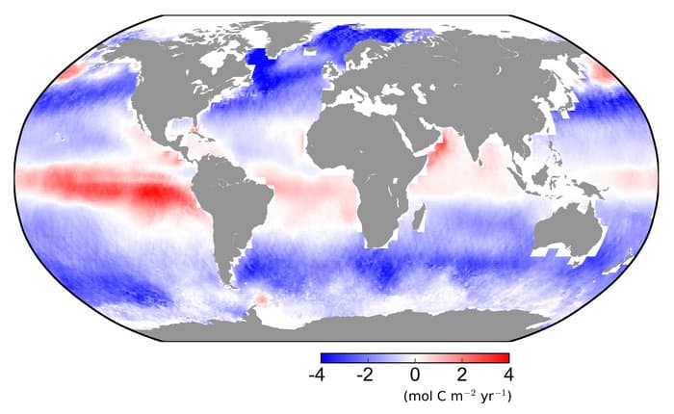
Oceans hold carbon dioxide
The oceans have absorbed about 50% of the CO₂ that humans have produced since 1950
If the oceans had not absorbed the CO₂ levels in the atmosphere would be closer to 600ppm (we are currently about 400 - 420 ppm)
CO₂ in the ocean is used by ocean plants, trapped in ice, settles to the bottom and is trapped in rocks, and used to make corals, and sea shells

Slide 7
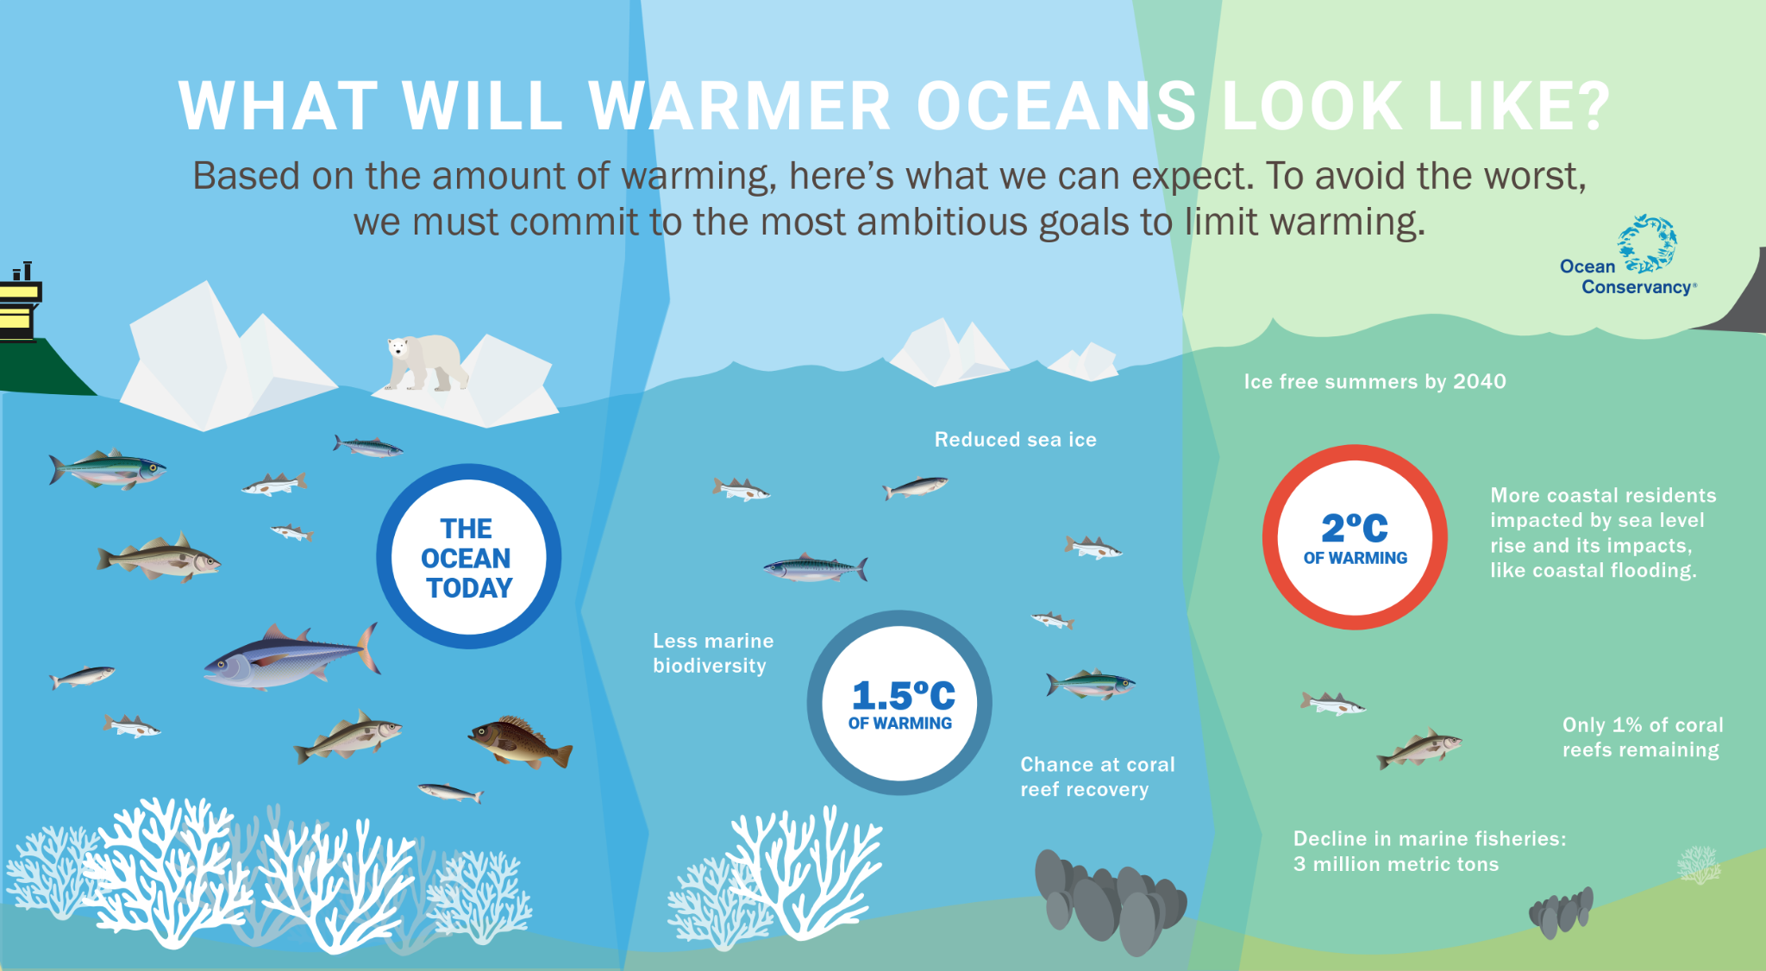
How climate change affects the oceans
Increased heat
Acidification
Deoxygenation

Slide 8
How do scientists measure the temperature of the ocean?

Slide 9
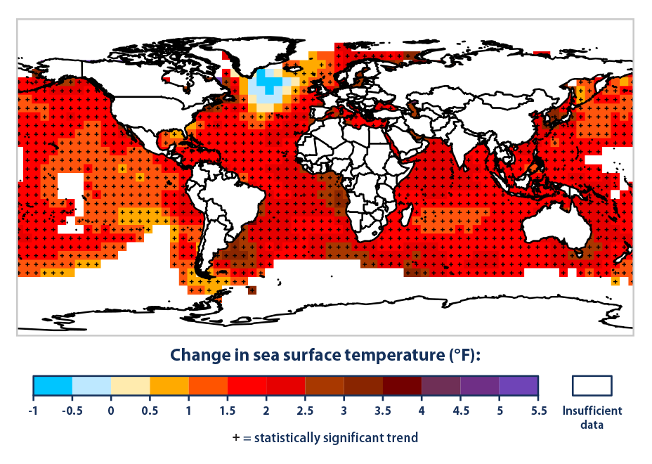
Increased heat - but maybe not everywhere
Where are the oceans heating the most?
Why are they warming?
Where are the oceans cooling?
What effect does this change in ocean temperature have on the global conveyor belt?

Slide 10
Increased heat - but maybe not everywhere
The equator and southern hemisphere
Increased air temperatures due to increased greenhouse gases
By Greenland - because the glaciers are melting into the ocean
Watch the Video for your assignment today to figure it out!
Where are the oceans heating the most?
Why are they warming?
Where are the oceans cooling?
What effect does this change in ocean temperature have on the global conveyor belt?

Slide 11
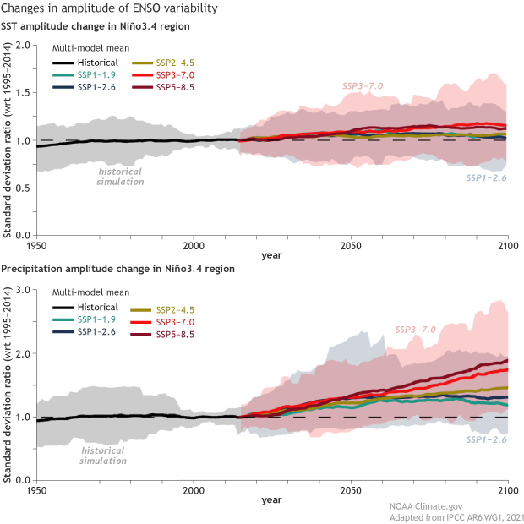
El Niño and La Niña Events
The ENSO may not be more frequent due to climate change
But the models all agree that El Niño will be wetter and La Niña will be drier
This means more flooding in some areas and more drought in others.

Slide 12
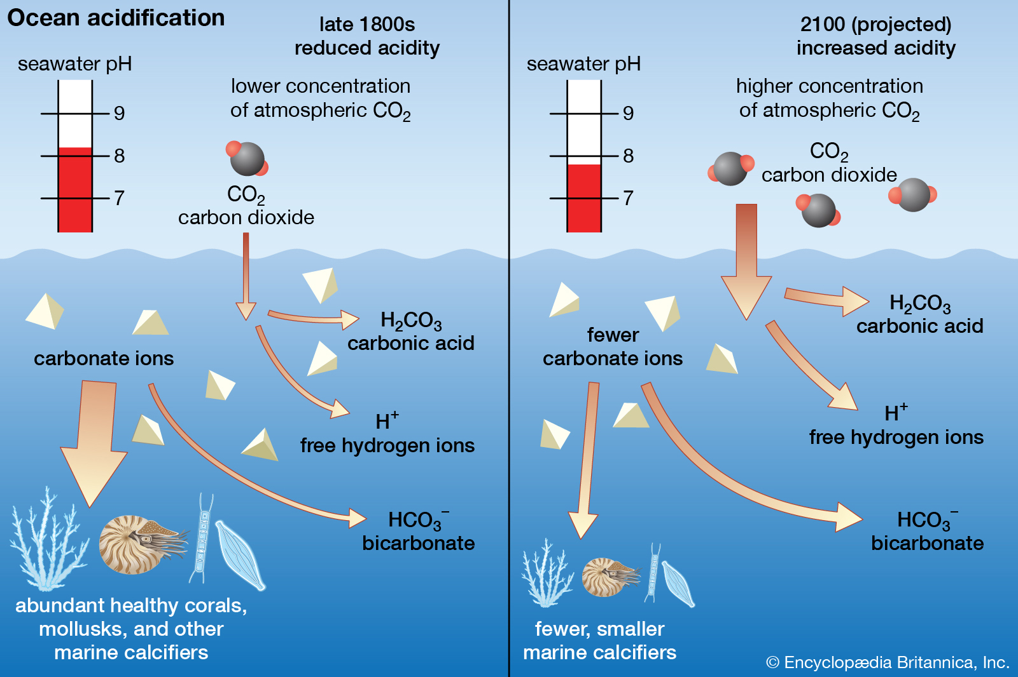
Ocean Acidification
Impacts on marine life.
What larger impacts does this have? So what if there isn’t coral and snails and things?

Slide 13
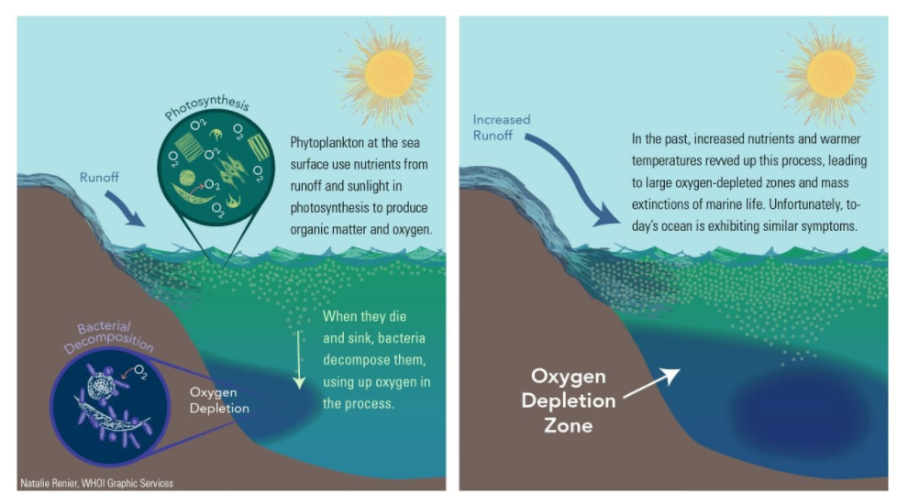
Deoxygenation
When the ocean gets too warm it can’t hold as much oxygen.
In addition, increased temps and increased nutrients from farm runoff increases algae growth. When the algae dies it uses the oxygen to decompose creating dead zones
Fish, mammals, and all living things in the ocean need oxygen.

Slide 14
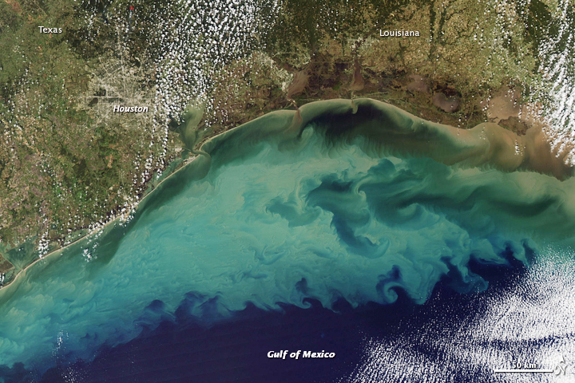
Deoxygenation
Blue Green Algae is toxic to living things.
Look at this algae bloom in the Gulf of Mexico.
Kills fish, and marine mammals
Not even humans can swim in this water

