Slide 1
Mitigation

Slide 2
What is mitigation?
the action of reducing the severity, seriousness, or painfulness of something.
What needs mitigating when it comes to climate?
Think about things that need reducing…
The cause of climate change?
The impacts of climate change?

Slide 3
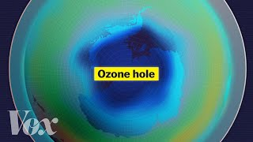
How does mitigation happen?
Watch this video and see what people did in order to mitigate the problem.
Notes:
Video - Why don’t you hear of the ozone anymore - VOX https://youtu.be/CaLOiGEDPJQ
Feel free to use other videos about the thinning of the ozone layer.

Slide 4
Ozone Layer Discussion
How did they mitigate the issue?
Personal - what did individuals do to help the ozone layer problem?
Public - what did the public do to help the ozone layer problem?
How did they carry out the mitigation strategy?
What did it cost? (Time/Money)
What are the benefits of the mitigation strategy?
What are the new negative of the mitigation strategy?

Slide 5
Cost/Benefit Analysis
If large problems such as the ozone layer and climate change were so easy to fix, we probably would have done it by now.
We have to consider the cost vs. the benefits of certain mitigation strategies.
Who does it help and who does it harm?
Let’s look at electric cars as an example…

Slide 6
Electric Cars Cost/Benefit Analysis
Do some research with your group, what are the pros and cons of electric cars?
Pros | Cons
No fossil fuels used as gasoline Less oil fields and oil having to be mined Runs on electricity Electricity can be from renewable sources such as wind, solar, and hydroelectric Once charged does not ACTIVELY produce CO₂ emissions TESLA factories are run 100% on solar | Lithium batteries Lithium has to be mined and habitats can be destroyed doing that Runs off electricity from your home which in Indiana is 75% produced from fossil fuels (coal & natural gas) Uses a lot of metal to produce the body Fossil fuels are used to power the factory that it was produced in Electric cars are more expensive - WHY?

Slide 7
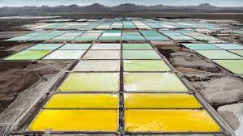
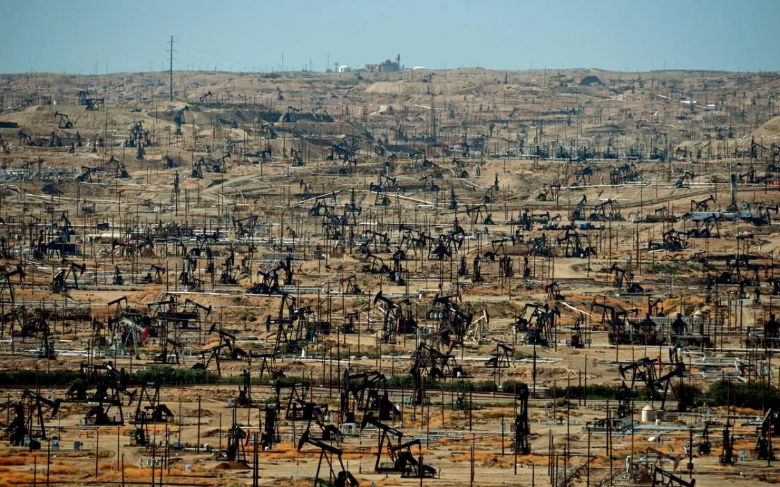
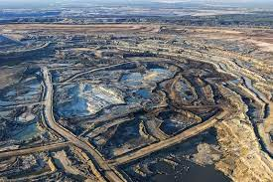
Lithium mining | Oil mining
Metal found in the earth and in salt water brine Major mining locations - Canada, Australia, Bolivia, Columbia Mining operations take up less space than oil operations 88 million tons of lithium estimated Batteries last up to 10/20 years Doesn’t produce CO₂ Can produce arsenic and pollute water sources | Crude oil is extracted from the earth from wells, tar sands Major oil reserves in Middle East and Russia Take up a lot of space and produce CO₂ just by drilling and releasing the oil from the Earth Water pollution from burst pipes, oil spills, etc. Makes money because most things still run on oil
Notes:
https://www.popularmechanics.com/science/energy/a42417327/lithium-supply-batteries-electric-vehicles/

Slide 8
What do you think?
Which is better?
Electric Vehicles or Gasoline Vehicles?

Slide 9
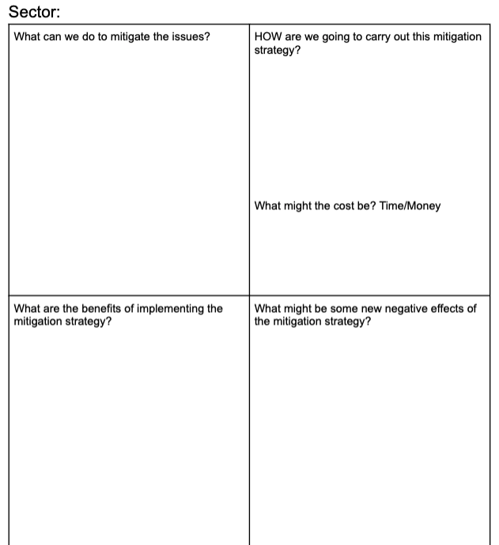
Your Turn!
One of the sectors will be assigned to your group. You will work with your group to do additional research and fill out your white board with the following template.
Agriculture
Land Use/Forestry
Transportation
Industry
Electricity
Commercial/Residential
Use your Mitigation Notes to help you get started.
Once the white boards are filled out, you will do a gallery walk and fill in your notes. Make sure to ask questions and to get explanations if you need them. These notes are for you and it's important you understand how complex mitigation strategies can be

Slide 10
From what you learned about mitigation, what is stopping us from fixing climate change?

Slide 11

Climate Change is NOT your fault, but you can help stop it
Notes:
https://youtu.be/h2J5C_cxJ0Y
Other helpful videos - https://www.youtube.com/watch?v=yiw6_JakZFc&feature=youtu.be
https://www.youtube.com/watch?v=TbW_1MtC2So

