Slide 1
Impacts of Climate Change
How are humans affecting climate and how is climate change affecting humans?

Slide 2
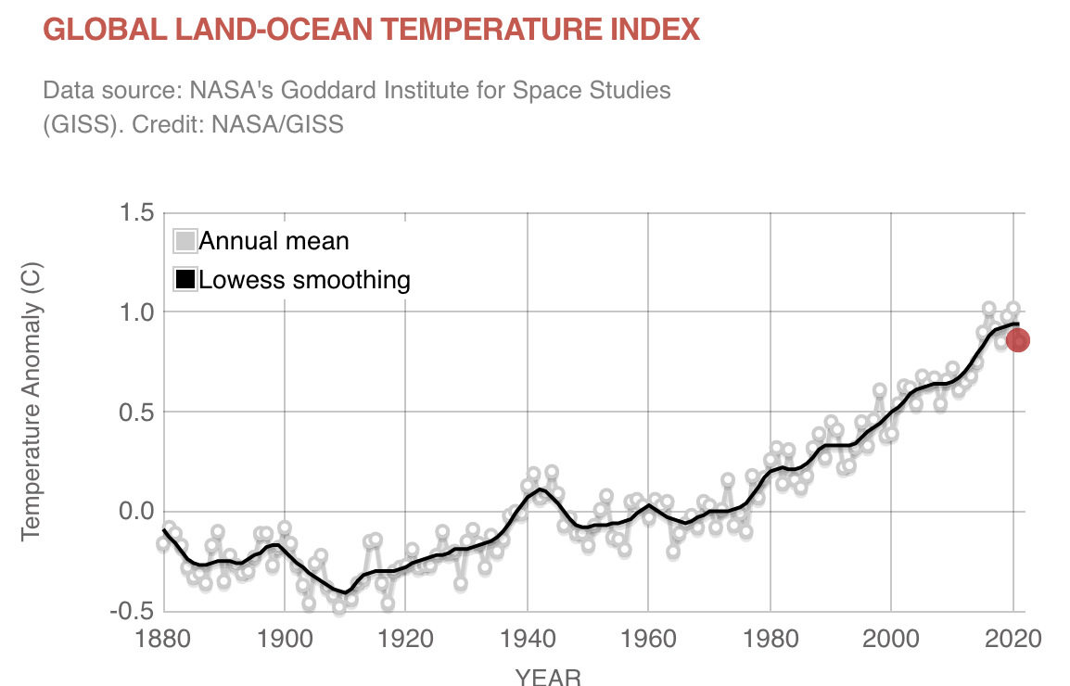
Anthropogenic Climate Change - How do we know?
Claim: Humans are causing Global Climate Change.
Evidence: List data trends of the graph
Reasoning: [Explain the significance of the graph In your notes.]
Source: climate.nasa.gov/index

Slide 3
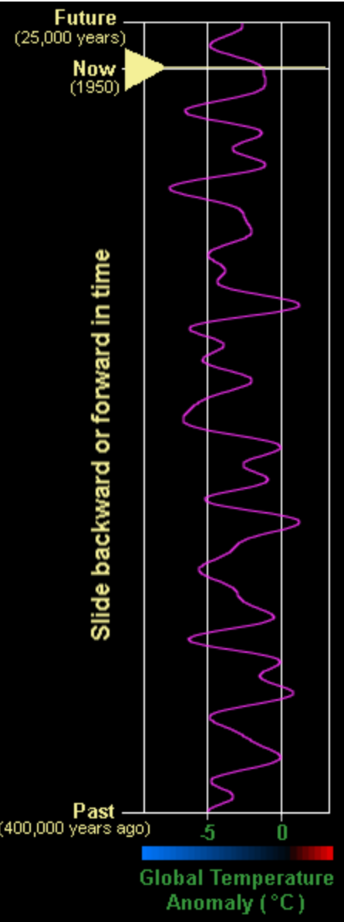
Anthropogenic Climate Change - How do we know?
Claim: Humans are causing Global Climate Change.
Evidence: (The Graph)
Reasoning: [Explain the significance of the graph In your notes.]
Source: https://cimss.ssec.wisc.edu/wxfest/Milankovitch/earthorbit.html

Slide 4
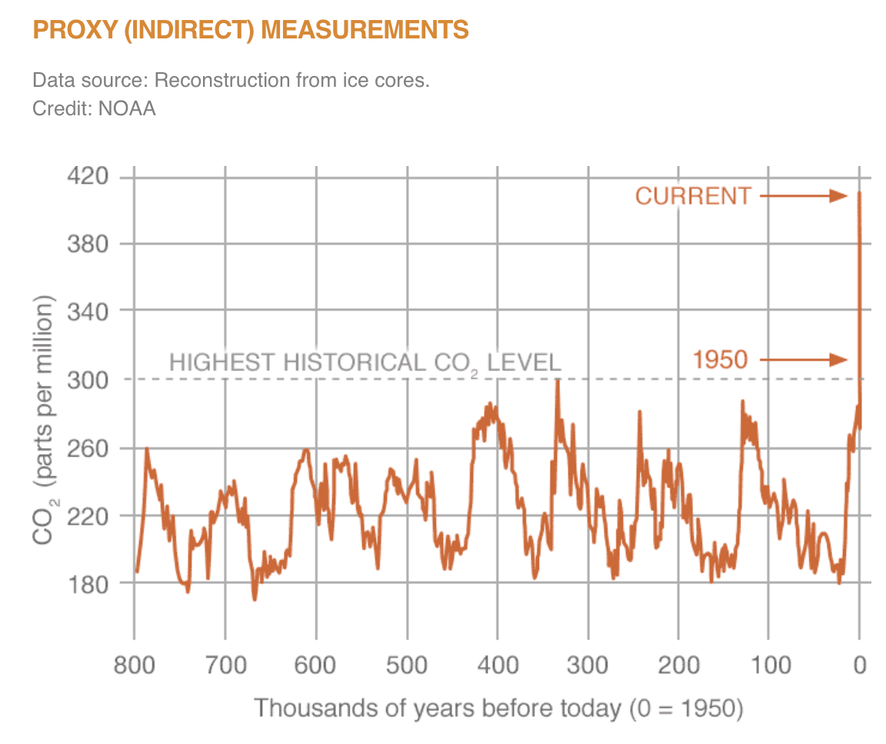
Anthropogenic Climate Change - How do we know?
Claim: Humans are causing Global Climate Change.
Evidence: (The Graph)
Reasoning: [Explain the significance of the graph In your notes.]
Source: climate.nasa.gov/index

Slide 5
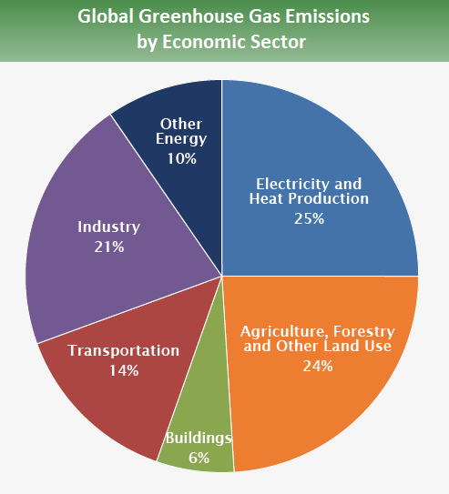
Ways humans are affecting the climate
Burning fossil fuels
Cars
Plastic
Energy - electricity
Meat consumption
More beef (cows) = more methane (CH₄)
We need water and energy to keep barns temperature controlled
Food for animals (see agriculture section below)
Meat processing
Agriculture
Tractors
Synthetic fertilizers - (N₂O)
Slashing and burning forests to make fields (palm oil)
Land use Change
Fields to parking lots (it produces CO₂ to make black top and concrete)
Forests to houses - forests store CO₂… housing developments do not
Albedo shifts
Landfills
Did you know that when your garbage decomposes in a landfill it produces CH₄?
Garbage is burned at landfills, which releases methane into the air
What else can you think of?
How about industry - where does that fit into the categories listed?

Slide 6
How the climate change affect humans
Rise in sea level
Housing displacement
Sea water intrusion in aquifers
Increased health issues
Asthma
Heatstroke
Allergies - increased pollen count
Wildfires
Housing displacement
Decreased crop yields
Even more CO2 in the atmosphere
Decreased crop yield (i.e. hunger)
Droughts
Too much flooding
Increased temperature
More severe storms
Need more infrastructure
Housing displacement
Collapse of Food Webs
Coral reefs (1 billion people depend on food from the coral reefs)
Infrastructure Change
Places that don’t have air conditioners are now getting record heat waves
Scarcity of freshwater resources
As water source dry up (drought), become salty (intrusion), or contaminated (flood)
Folks can’t live without freshwater
What else can you think of?

