Slide 1
Aspects of Climate
Atmosphere

Slide 2
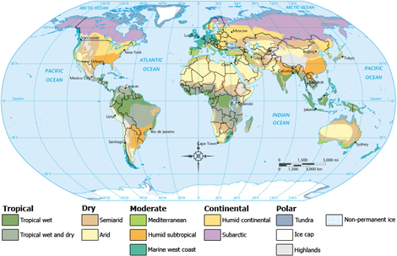
How are these climate zones formed?

Slide 3


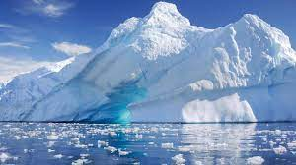
How are Climates formed?
Interaction between the hydrosphere, atmosphere, and cryosphere

Slide 4
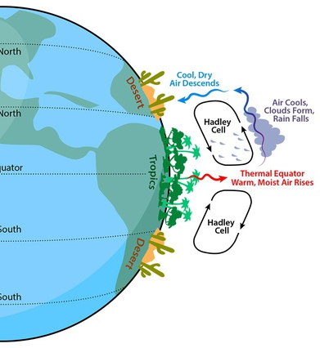
Remember Atmosphere Circulation
Uneven heating of the earth creates circulating air cells
  Hotter air rises - low pressure - clouds & rain
  Colder air falls - higher pressure - sunny - dry
Warm air comes away from the equator
Cold air comes away from the poles
The circulation of the atmosphere distributes the atmosphere molecules evenly around the globe

Slide 5
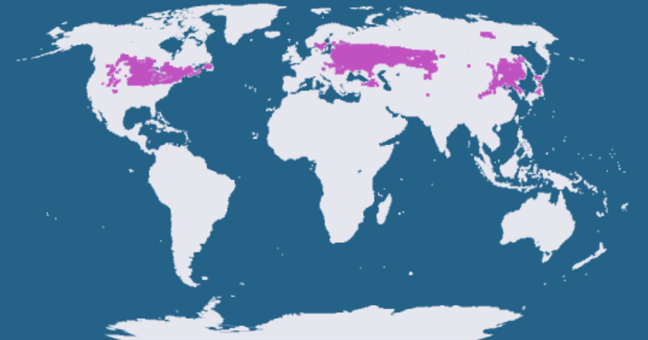
How are climate regions created?
Humid continental climate (what we have here in indiana)
Precipitation: Gets precipitation all year as either rain or snow
Temp: Hot summers and cold winters
Atmosphere -
warm wet air comes from the distant oceans. The warmer the atmosphere the more water it can hold and is humid - low pressure - clouds

Slide 6
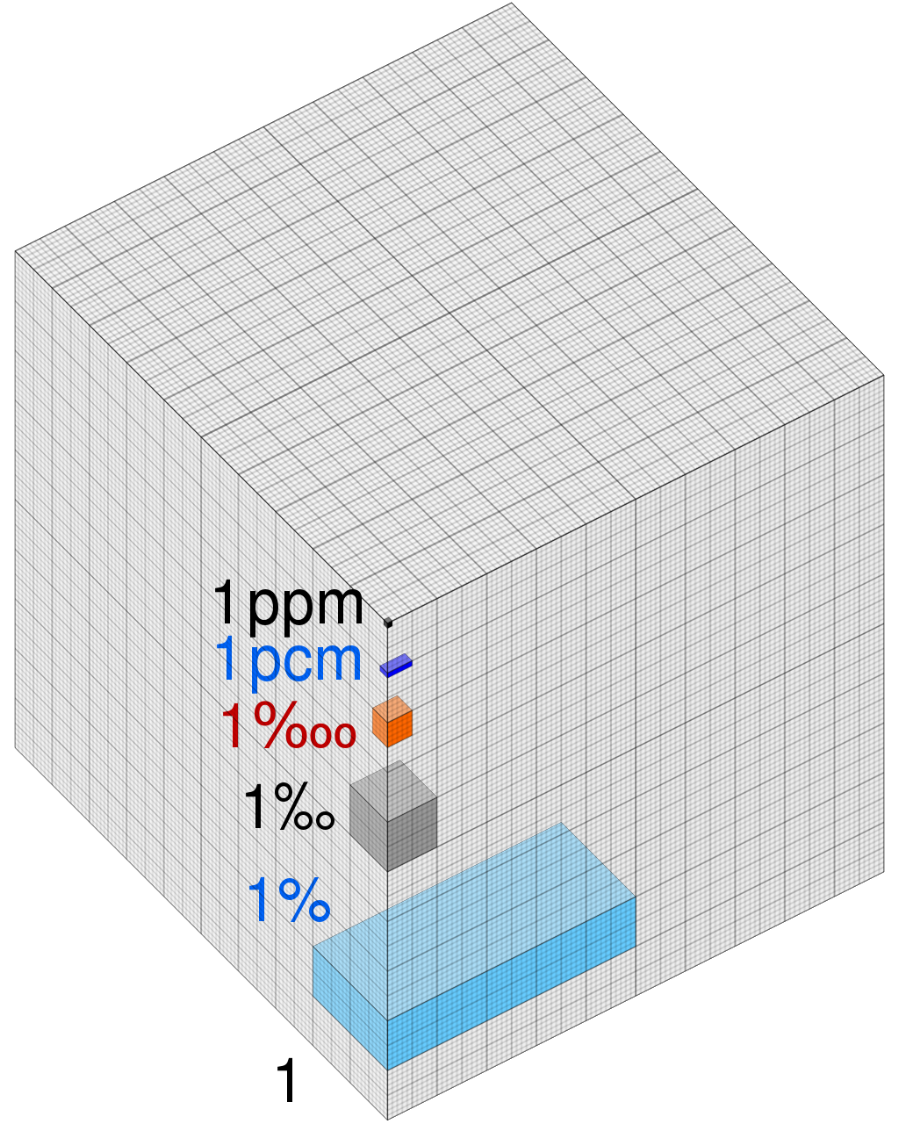
Remember Atmosphere Composition
Remember what the atmosphere is made of
78% Nitrogen
21% Oxygen
400 ppm Carbon Dioxide
Wind and atmospheric circulation means that there isn’t more oxygen (or CO2) in one part of the world than another

Slide 7
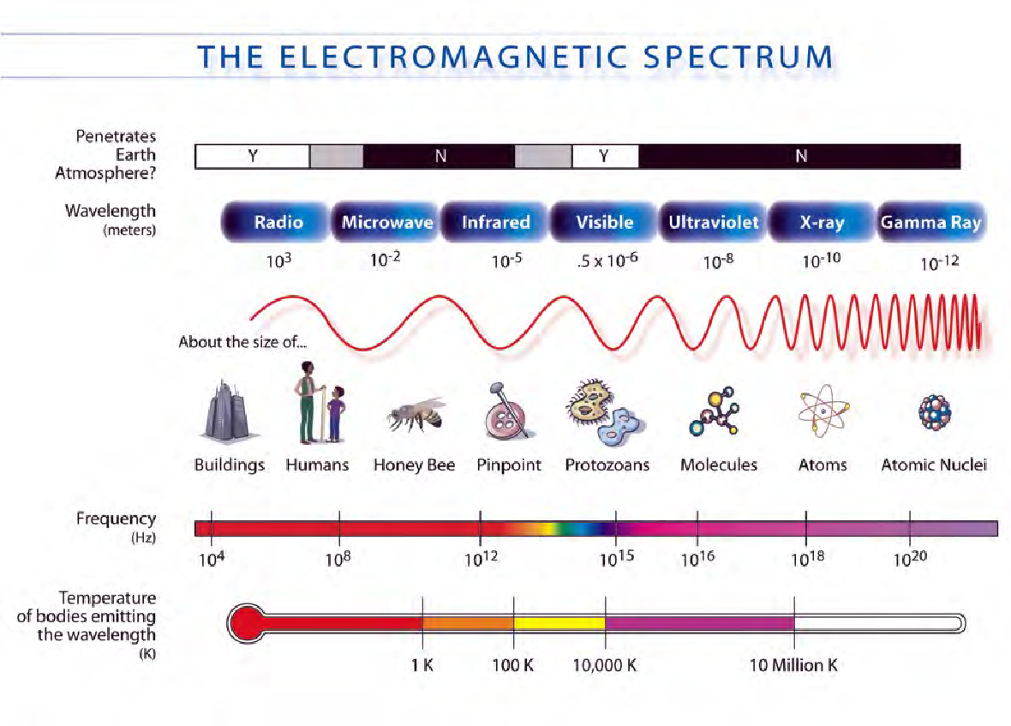

Solar Energy Review!
Remember what the sun gives us?
The energy we receive from the sun is our currency. It’s the energy that powers everything on Earth.
Solar energy comes in all forms of the electromagnetic spectrum
Short wavelengths come in in the form of UV and visible light
Transfers to long wavelength heat (infrared) after being temporarily absorbed by the ground

Slide 8
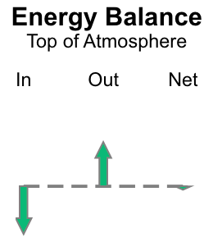
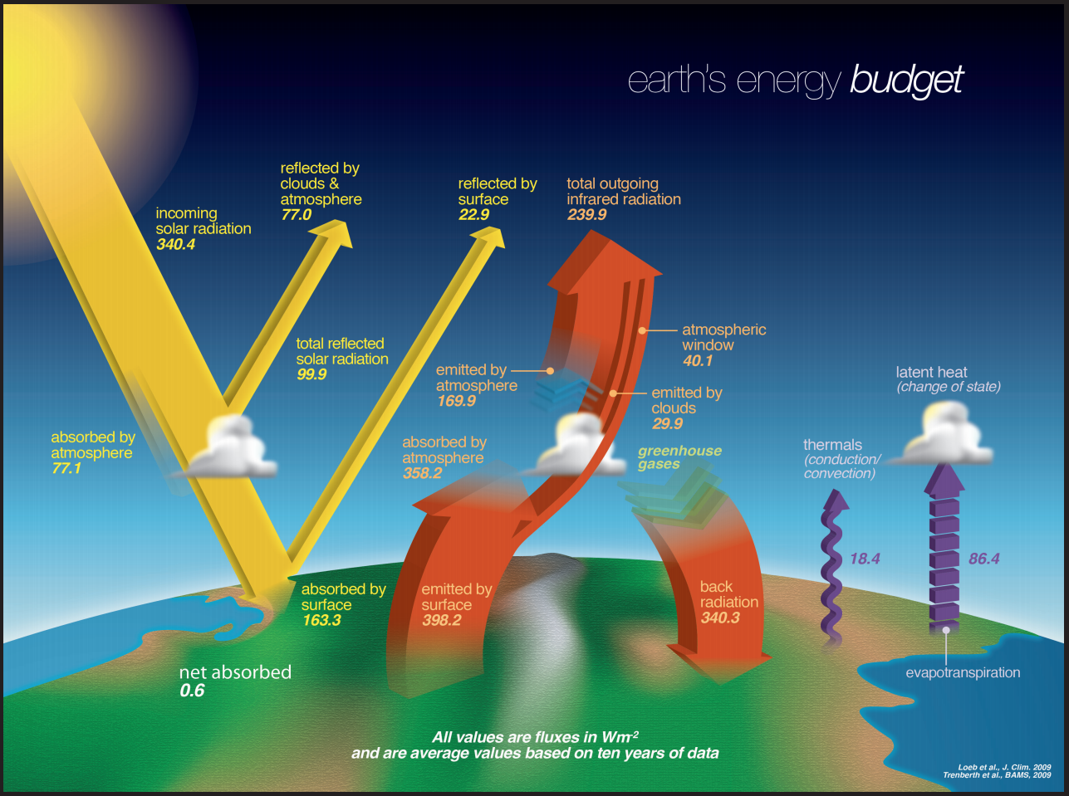
Earth’s Energy Budget
What you will see in the lab simulator today
The energy we receive from the sun is absorbed, reflected, or transmitted
Some sunlight is reflected back into space (bounces off clouds and other high albedo things)
Some is absorbed by land and water as heat (infrared energy)
The Earth releases that heat over a period of time
Our atmosphere helps hold some heat through the greenhouse effect
What we want is the same amount of energy in to balance the amount of energy out.

Slide 9
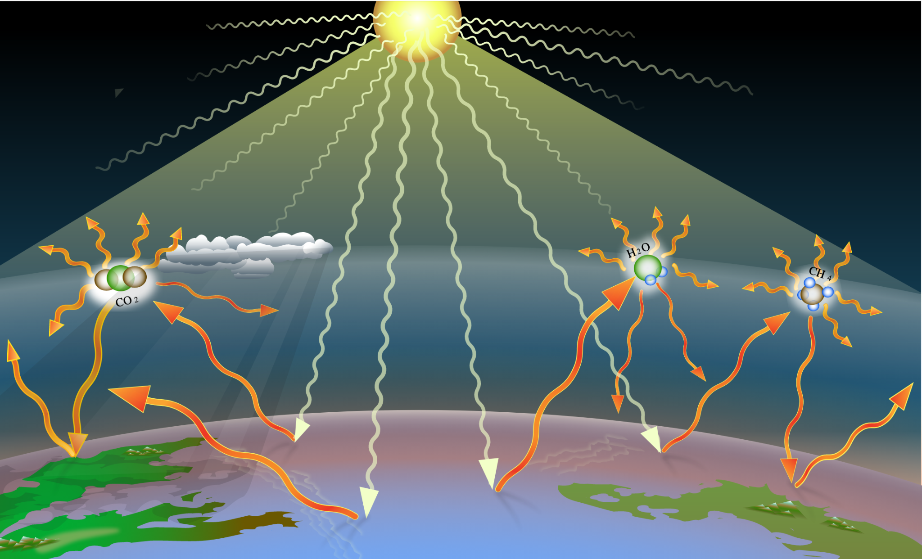
Greenhouse Gases - CO2
How do greenhouse gases affect the atmosphere?
  GHG absorbs and then re-emits heat into the atmosphere
What would happen if there were too little greenhouse gases?
What would happen if there were too much greenhouse gas?

Slide 10
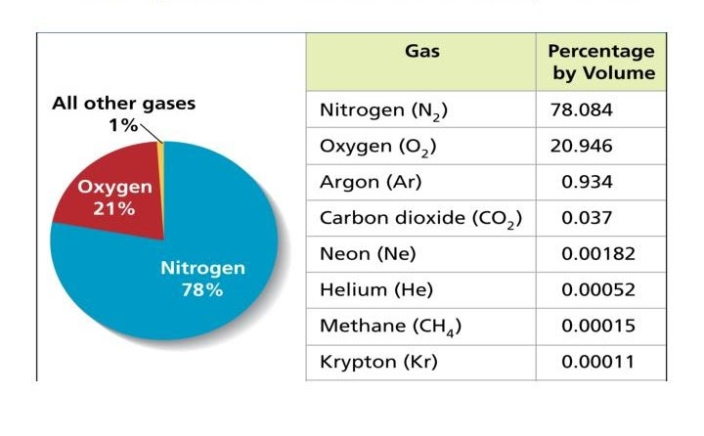
The Greenhouse Gases
The big four are:
Water Vapor (H₂O)
Carbon Dioxide (CO₂)
Methane (CH₄)
Nitrous Oxide (N₂O)
Where do Methane and Nitrous Oxide come from?
(davina, 2014)

Slide 11
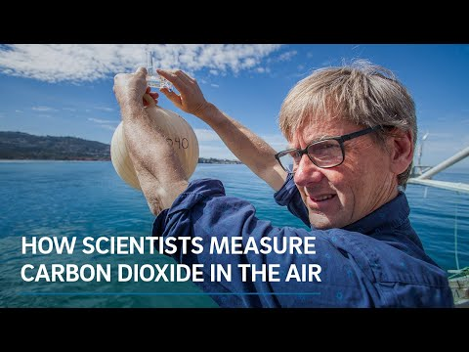
How do we measure the greenhouse gases in the atmosphere?

Slide 12
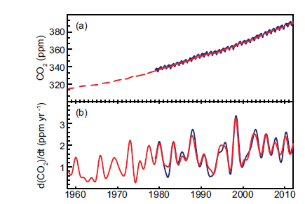
Before 1780 (Industrial Revolution) the level of carbon dioxide was 280 ppm
By 1950 it was 300 ppm
Today Carbon Dioxide levels are 400 ppm
Currently, Carbon Dioxide levels increase by about 1.7 ppm per year
The hottest the planet has ever been with life on it was during the Paleo-Eocene Thermal Maximum (55mya) where CO2 levels were 650 ppm-3500 ppm
How long do we have if we keep increasing at this rate?
Carbon Dioxide on the Rise

Slide 13
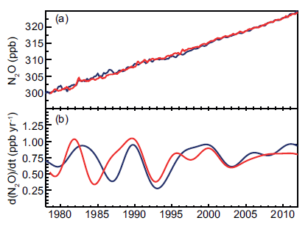
Nitrous Oxide is also increasing
The increase is likely from the use of nitrogen fertilizers in agriculture
Since systematic testing started in the 1970’s N2O has increased nearly .75 ppb each year
(AR5 Climate Change 2013, n.d.)

Slide 14
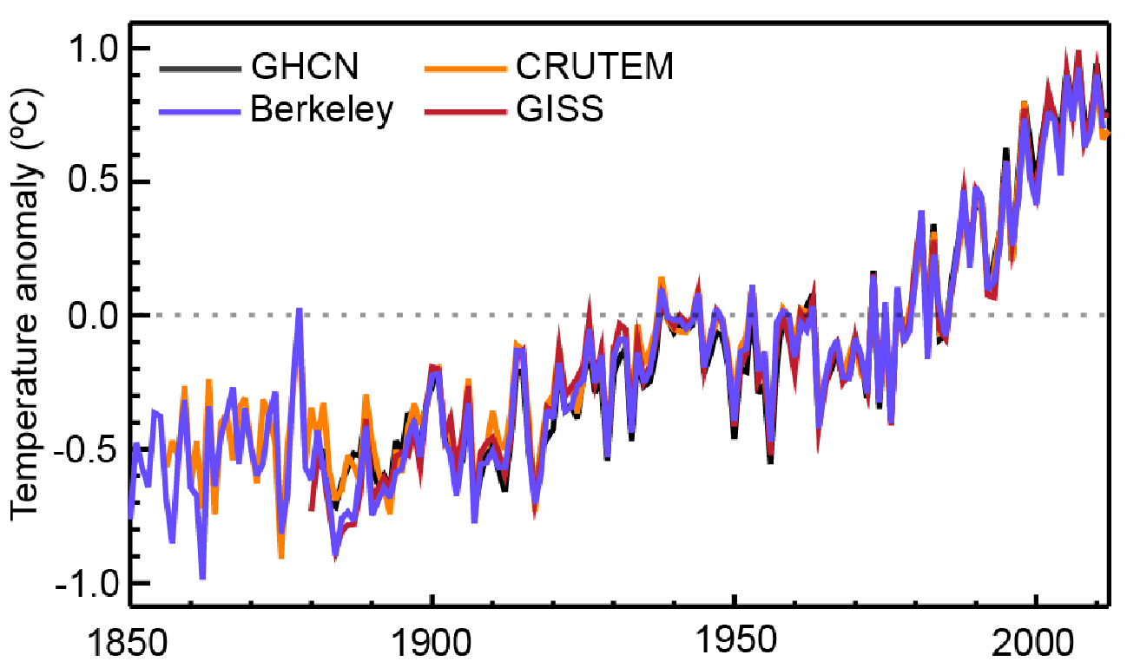
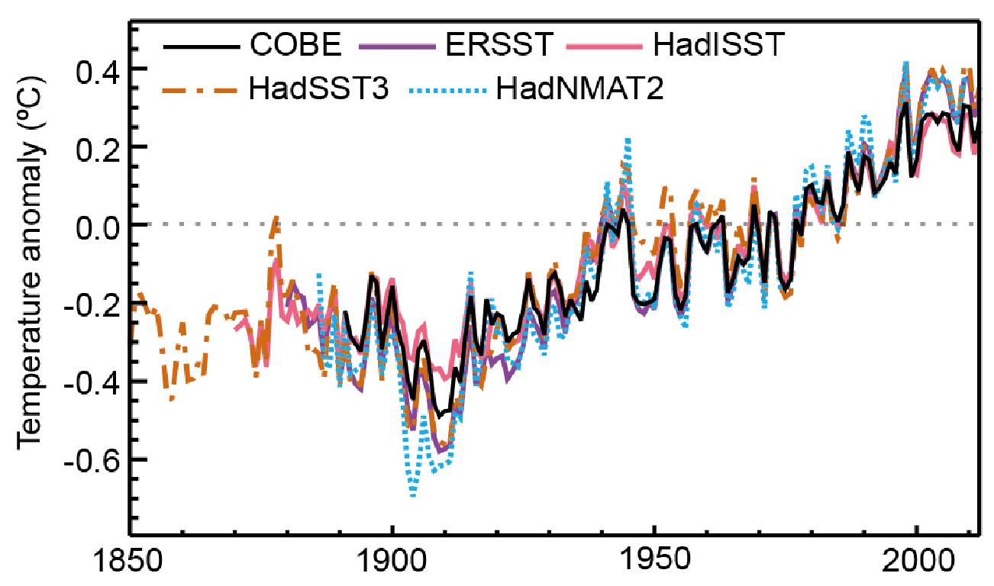
As Greenhouse Gases Increase What Happens to Temperature on Land and in Oceans?
Land Temperature Anomaly
Ocean Temperature Anomaly
Land surface air temperature record
Sea surface temperature and oceanic air temperature
(AR5 Climate Change 2013, n.d.)

